Slide 1
COMP 2710 Software Construction
Separate Compilation
Dr. Alvin Lim
Auburn University
http://www.eng.auburn.edu/~lim
limalvi@auburn.edu
Fall 2014
These slides are adapted from notes by Dr. Walter Savitch (UCSD)

Slide 2
Why Separate Compilation?
Compiling a single C++ file doesn’t take that long. . .
If we change one c++ file, we do not want to re-compile all of them — it might take too long to complete
Just re-compile only the changed c++ file to produce an object file and then link it with the other object files
11-<number>
Notes:
o . . . however, compiling several hundreds of them might take (literally) hours
o Since .h files are included in .c++ files, if we change one .h file we will then have to re-compile all the .c files that include it

Slide 3
Why Separate Compilation?
Encapsulation Reviewed
Encapsulation principle:
  Separate how class is used by programmer
  from details of class’s implementation
"Complete" separation
  Change to implementation → NO impact on
  any other programs
Basic OOP principle
Copyright © 2008 Pearson Addison-Wesley. All rights reserved.
11-<number>

Slide 4
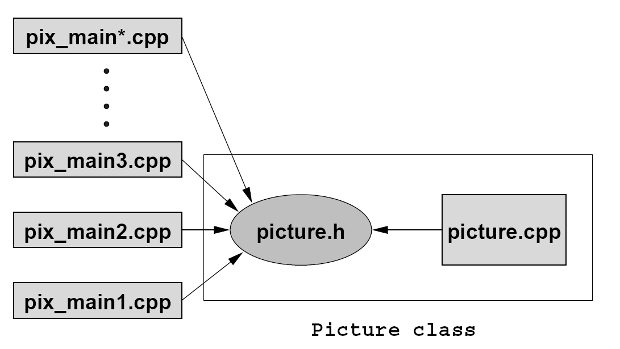
Build Library of Classes
Class definitions
  Separate from "using" programs
  Build library of classes
    Re-used by many different programs
    Just like predefined libraries
11-<number>

Slide 5
How Does it Work?
Program Parts
  Kept in separate files
  Compiled separately
  Linked together before program runs
Class Independence
  Separate class definition/specification
    Called "interface"
  Separate class implementation
  Place in two files
11-<number>
Notes:
If implementation changes → only that
file need be changed
Class specification need not change
"User" programs need not change

Slide 6
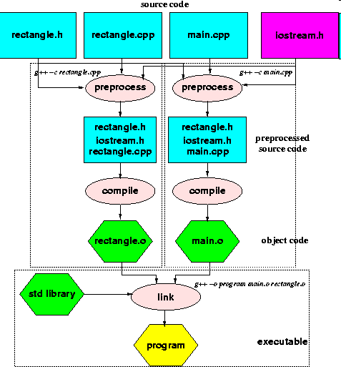
11-<number>
Notes:
If implementation changes → only that
file need be changed
Class specification need not change
"User" programs need not change

Slide 7
More Class Separation
Interface File (header, *.h)
  Contains class definition with function and
  operator declarations/prototypes
  Users "see" this. Programs that use class will "include" it
    #include "myclass.h"
  Separate compilation unit
Implementation File (*.cpp)
  Contains member function definitions
  Separate compilation unit
11-<number>

Slide 8
Demo
dtime.h
dtime.cpp
timedemo.cpp
g++ -c dtime.cpp
g++ -c timedemo.cpp
g++ -o timedemo dtime.o timedemo.o

Slide 9
Summary
Can separate class definition and implementation → separate files
  Separate compilation units
Copyright © 2008 Pearson Addison-Wesley. All rights reserved.
11-<number>

